Slide 1

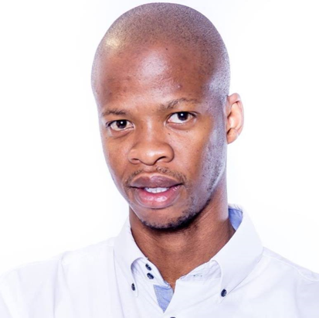
Machine Learning Challenge
Big Data Citizen Program
Team Name : VodaNumpys - South Africa
Michael Kaudi
Specialist: Radio Planning and Optimization
Country: South Africa
Department: Technology
" I joined the program so I can enhance my understanding of the Big Data field and how it can simplify and make more efficient the day-to-day activities. This with the aim of pursuing a career in this field.”
Mohau Masukela
Specialist: Radio Planning and Optimization
Country: South Africa
Department: Technology
“I joined because Data Science is one of the fastest growing industries and all major organizations are using it to learn their customers behavior towards their product and improve customer satisfaction”
Further together

Slide 2

Business Poblem | VodaPay
What?
Why?
Data?
Will a VodaPay customer be active or not in the following month based on data of past user behaviour resulting in active and inactivity.
Active users contribute positively to revenue and provide Vodacom with an opportunity to impact customer’s lives positively by the products and services we provide.
Data collected over a 4 months period. The data includes user id’s, registration dates, platforms used to interact with the app, user expenditures over different periods and search events.

Slide 3
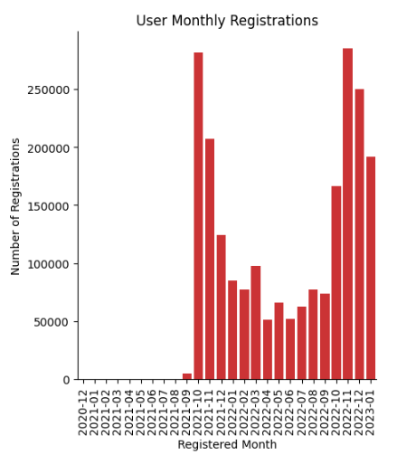
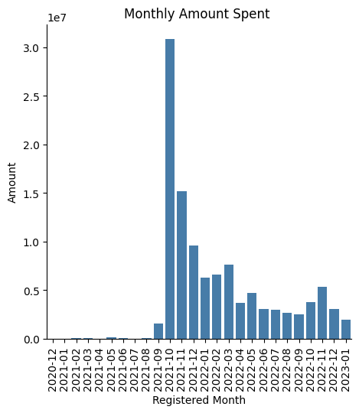
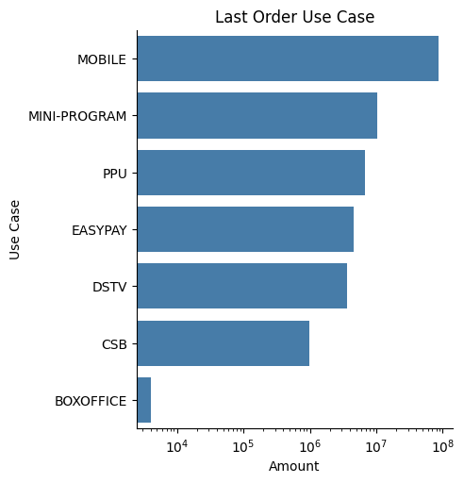
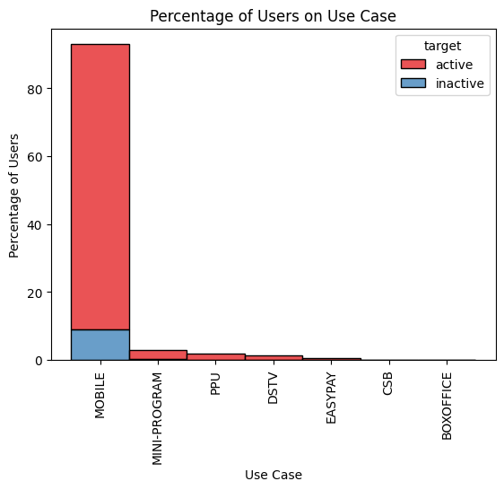
Data Insights
Yearly, registrations pick up between the months of October and December.
Related to the App’s launch and anniversary promotions.
User registrations spikes are not translating to increased expenditure on the app.
Most users interact with the app by mobile platform.
High percentage of active users use the mobile platform to interact with the app than inactive users.

Slide 4
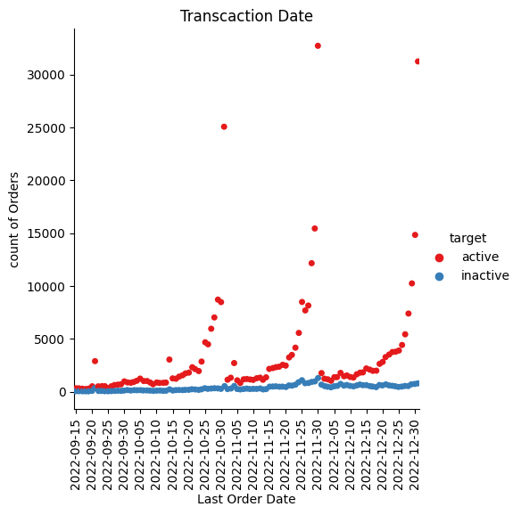
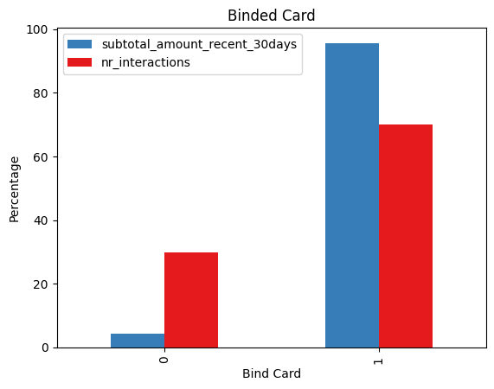
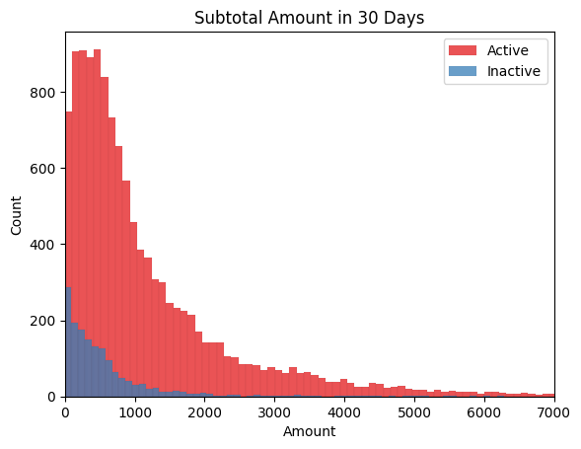
Data Insights
Orders for active users increase sharply during month-ends.
Users who have their cards linked to the app, interact and spend more than those that have not.
Active users spend close to 3 times more than inactive users. Keeping users active increases chances of increased spend.

Slide 5
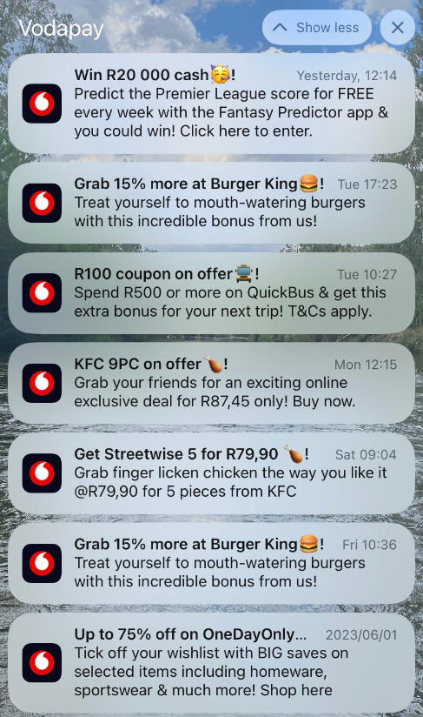
Improvement Ideas
“Peer-to-peer” data request: a user can request data from another users through the VodaPay app. Target low spending data users with notifications for the service.
Optimize targeted notifications to a user’s behaviour; that is, a user that frequently buys airtime/data should get notifications on discounts related to same.
Visibility marketing onsite at partner stores with discounts to encourage app usage.
Come up with VodaPay focused media adverts detailing specific benefits/discounts aired during low interaction days to encourage app usage and spend.
Reward users on activity anniversaries (3months/6months/12months etc.) to encourage users to stay active and spend.
Investigate streamlining the apps; remove apps that a user has not used for a certain amount of time on the home screen but they can still search them.
As soon as a user installs and registers on VodaPay – prompt them to disable/migrate the MyVodacom App profile to VodaPay. This will expose them to services offered in the VodaPay app while still enjoying same services on the MyVodacom mini app.

Slide 6
Thank you Ke a leboha
Notes:
Demo of finished model aimed at increasing the uptake and usage of the Airtime Advance facility.
Use case summary, Training data design, Model flow, design and performance, EDA insights into chosen features and finally campaign strategy and pilot discussions

